Slide 1

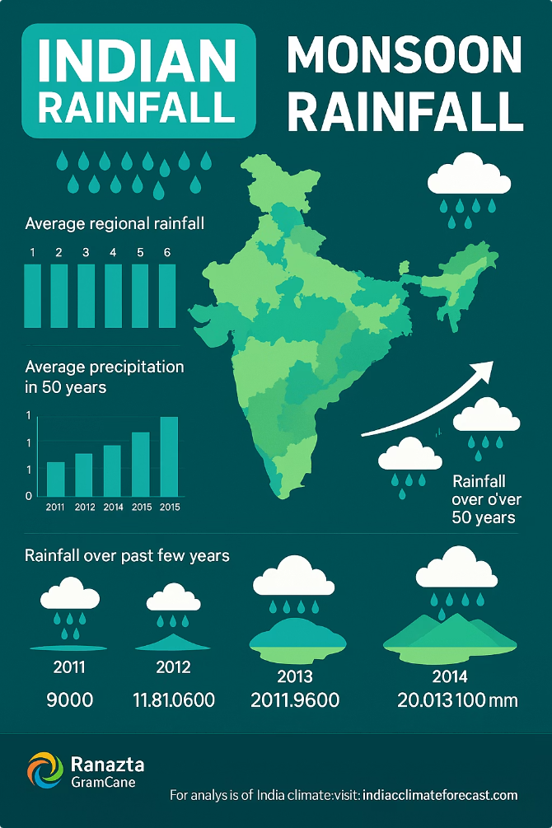
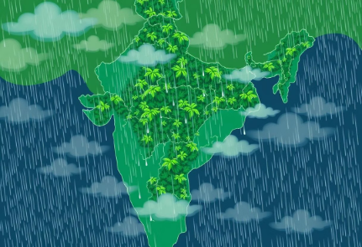
Government Dataset Indian Rainfall Dataset Analysis (1901-2021)
Comprehensive analysis of monsoon rainfall trends, regional patterns, and seasonal variations.
Additional visualizations including regional subdivisions and key rainfall receiving areas will be explored throughout the presentation.

Slide 2
Dataset Overview
Covers rainfall data for Indian subdivisions from 1901 to 2021.
Includes monthly rainfall (June-September) and total monsoon rainfall.
4,332 records with 7 attributes: Subdivision, Year, and Monthly Rainfall (mm).
Useful for studying monsoon trends, climate change impacts, and regional disparities.

Slide 3
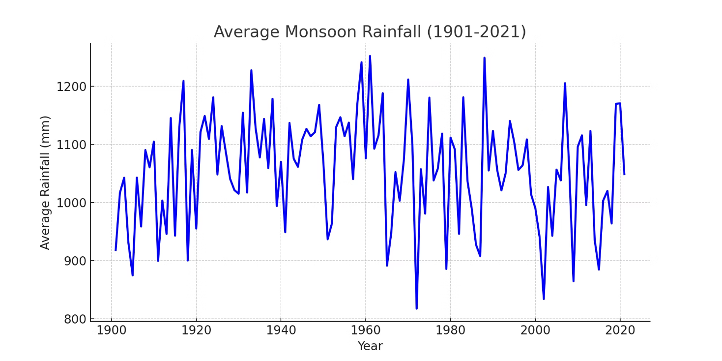
Yearly Rainfall Trends (1901-2021)
This plot illustrates the trend in rainfall over time, highlighting seasonal variations and regional disparities.

Slide 4
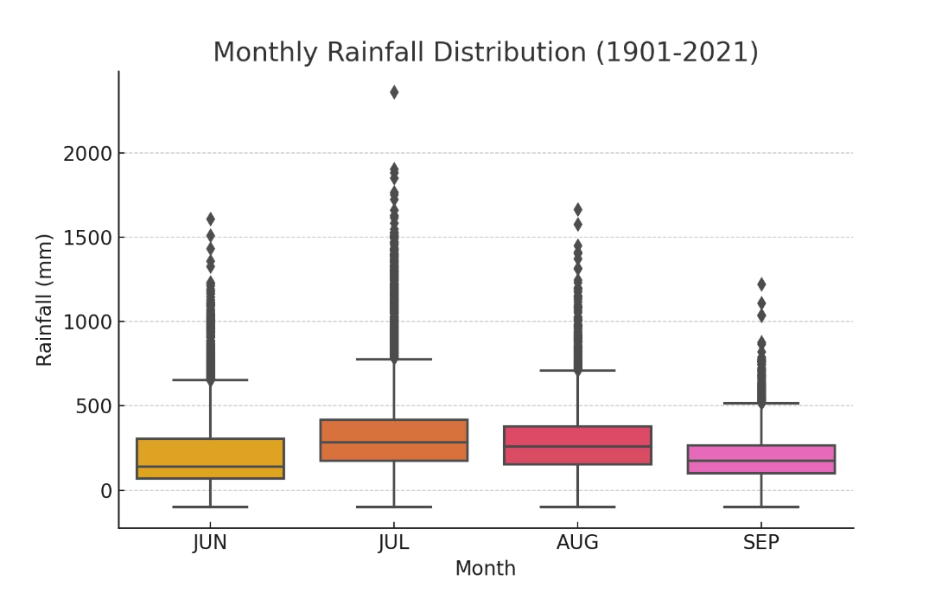
Monthly Rainfall Distribution (June-September)
This plot illustrates the trend in rainfall over time, highlighting seasonal variations and regional disparities.

Slide 5
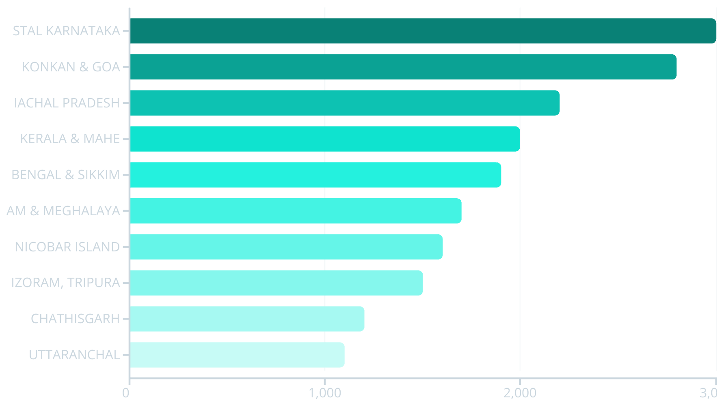
Top 10 Rainfall-Receiving Subdivisions
This plot illustrates the trend in rainfall over time, highlighting seasonal variations and regional disparities.

Slide 6
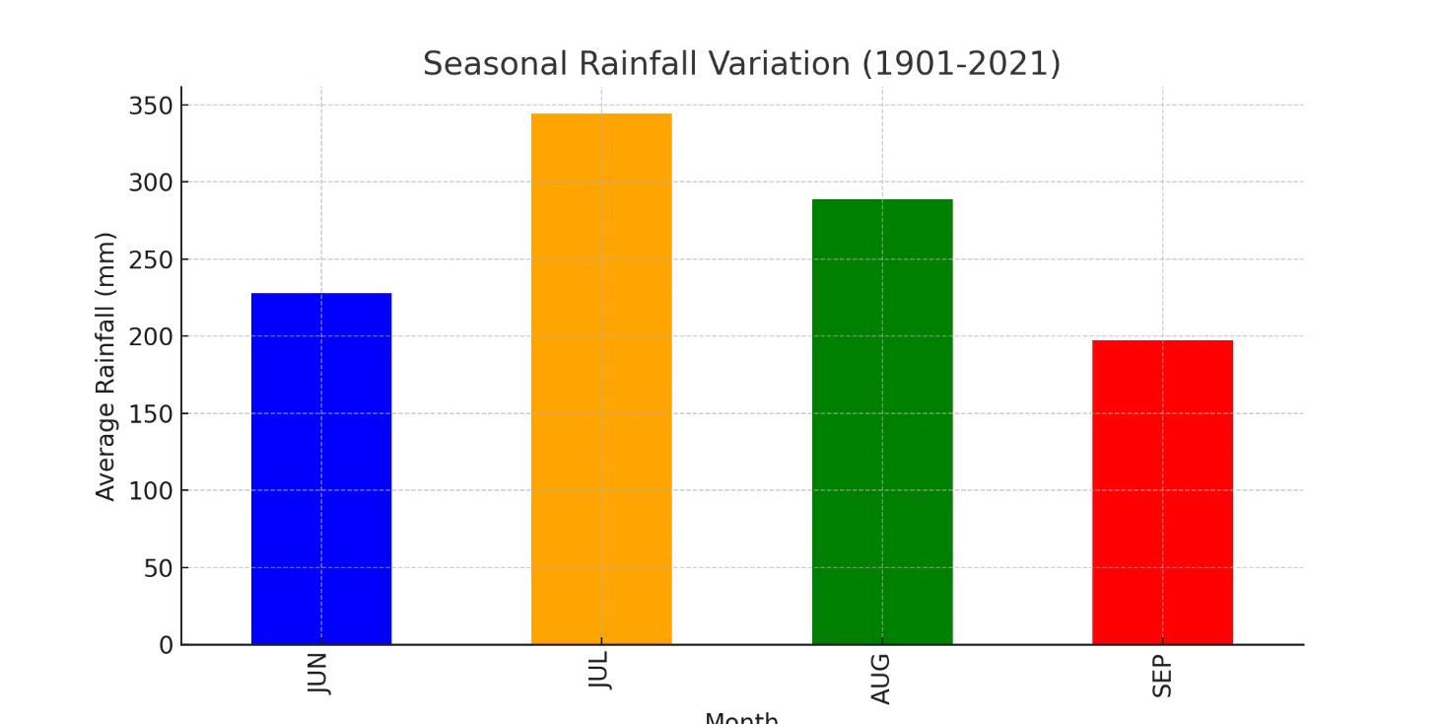
Seasonal Rainfall Variation (June-September)
This plot illustrates the trend in rainfall over time, highlighting seasonal variations and regional disparities.

Slide 7
Key Insights & Conclusions
Monsoon rainfall varies significantly over the years.
July and August receive the highest rainfall on average.
Certain regions experience much higher rainfall than others.
Seasonal variations highlight the importance of monsoon months.
Useful for agricultural planning, water management, and climate studies.

